Slide 1
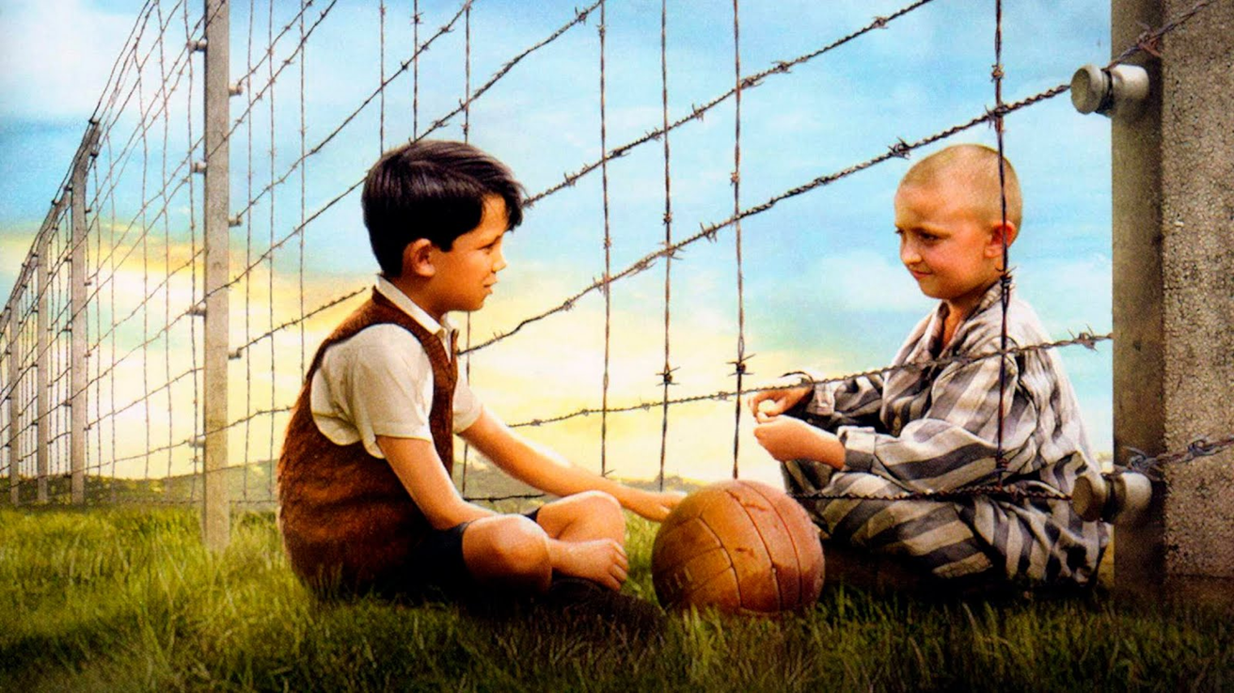
The Boy in the Striped Pyjamas
Miss Beathe

Slide 2
Learning Outcomes
WALT: Reading and Comprehension
WILF:
Reading and comprehension
Chapters 7&8 -I do, we do, you do
Punctuation: Capital Letters and Full Stops
TIB: We learn about characters by how they act and what they say.

Slide 3
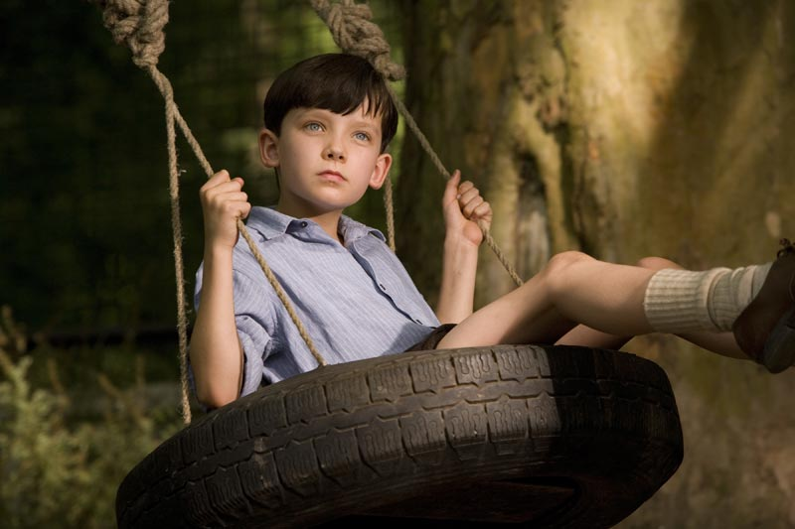
Character Wall: 13 Word Challenge

Slide 4
Spelling Pre-Test
adventurous
disastrous
enormous
famous
jealous
mischievous
nervous
ridiculous

Slide 5
Spelling Rule - ous

Slide 8
Check for Understanding: Noun or Adjective?
monstrous virus
Fungus
asparagus
ludicrous

Slide 9
Question One (I do, We do, You do)
Herr Roller was the one person Bruno knew to be mad. Decide whether each of the following statements is True (T) or False (F) by reading pages 69 & 70.

Slide 10
Steps for Reading SQ3R
S
Scan the text and look at the title
Read the question that you need to answer
Read
Recite your answer
Review your answer
Q
3R

Slide 11
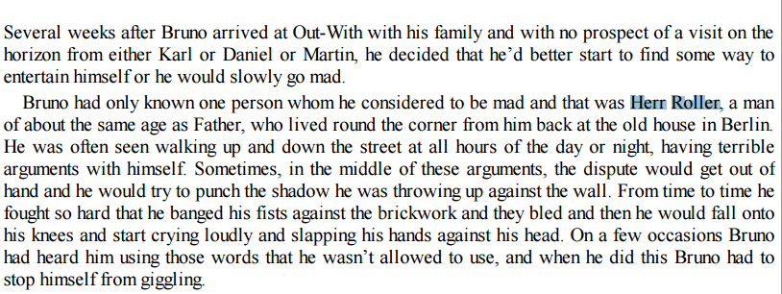

Slide 12
Chapter 7, Question 1.
He was much older than Bruno’s father.
He was often seen having terrible arguments with himself.
He wandered around the streets of Berlin, day and night.
Bruno could not understand the words Herr Roller used when he was upset.
Herr Roller’s Christian name was Franz.
F
T

Slide 13
Chapter 7, Question 2
Outline the way in which Bruno entertains himself. Explain why he decides to do this.
This question asks us to do two things

Slide 14
Step One: Scan the text
Step Two: Read the Question
Step Three: Read

Slide 15
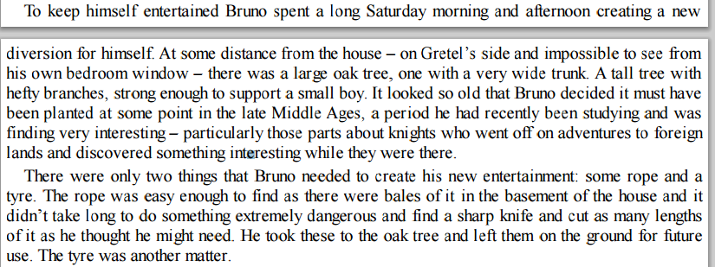

Slide 16
Step Three: Recite the Answer
Bruno entertained himself through constructing a swing using the following items: tyre, rope and the oak tree.
He decided to do this because firstly, he was lonely and bored, having to leave his friends behind. Secondly, he was curious about the ‘strange farmers’ who lived in the yard behind their house. He intended to use the swing to look over the fence and into the yard to find out more about the people who lived at Out-With.

Slide 17
Chapter Seven Answers
3. List the dialogue Kotler uses to speak to Pavel. Decide whether it is different from the way he speaks to others and explain your decision.
Hey you!
“Take this little man to the storage shed at the back of the main house. Lined up along a side wall are some old tyres. He will select one and you are to carry it wherever he asks you to, is that understood?”
‘And afterwards, when you return to the kitchen, make sure you wash your hands before touching
any of the food, you filthy—’
Off you go then

Slide 18
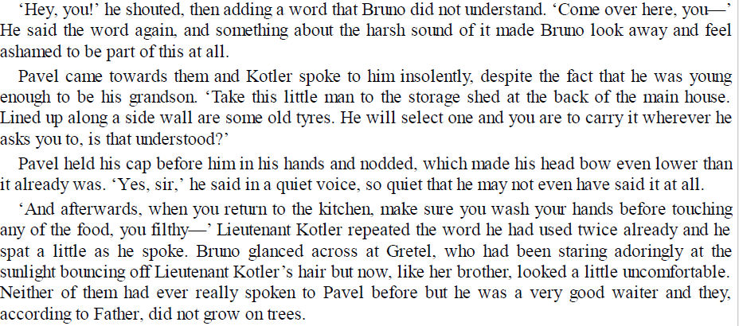

Slide 20
Chapter Seven Answers
4. At the end of the chapter, Mother tells Pavel, “If the Commandment asks, we’ll say that I cleaned Bruno up.” Explain why you think Mother says this.

Slide 21
Chapter Seven Answers
List three adjectives you would use to describe Gretel’s behaviour around Lieutenant Kotler.

Slide 22
Punctuation: Full Stops (.)
Full stops are used at the end of statements to show that the sentence has reached its conclusion.

Slide 23
Punctuation: Capital Letters
The most important function of a capital letter is to signify the beginning of a sentence.

Slide 24
Capital Letters: Proper nouns
All proper nouns are capitalised.
All the main words in the titles of texts such as films, books, plays, poems and novels are capitalised.
The Boy in the Striped Pyjamas
bruno, gretel, nazi, germany, kotler, pavel
Job titles and positions are capitalised.

