Slide 1
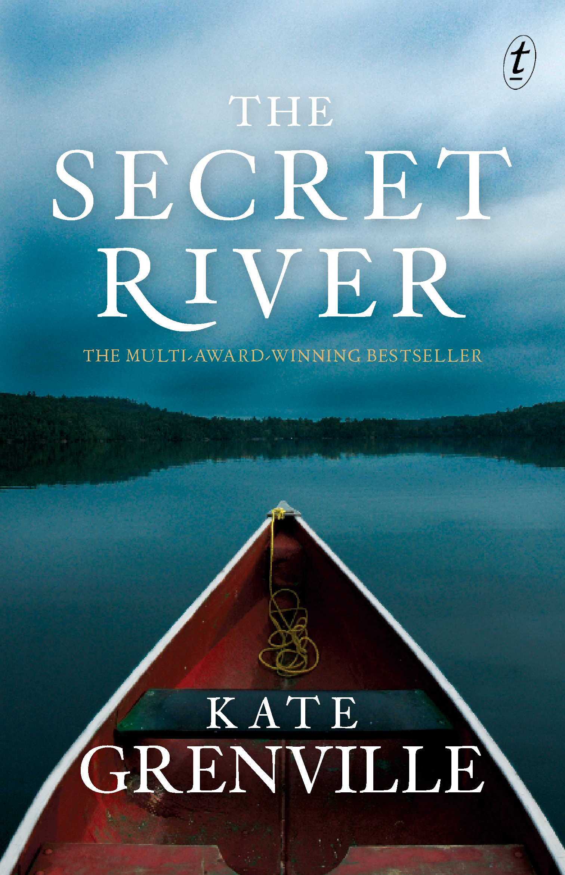
Context: Indigenous Culture and the Frontier Wars
Lesson Two
Miss Beathe
Year 11 English

Slide 2
Learning Focus: Context: Indigenous Culture and the Frontier Wars

Slide 3
Learning Outcomes
WALT: Introduction to the novel The Secret River
Indigenous Culture
Frontier wars
WILF:
Indigenous culture overview
Frontier Wars comprehension
We Are Going poem analysis
compare and contrast Indigenous and colonial values
TIB: Exploring the text beyond its specific words is relevant to understanding its intended meaning.

Slide 4
Rapid Recall: Rapid Fire Questions
How long have Aboriginal and Torres Strait Islander people lived in Australia?
When was Australia first settled by the British?
What was the name of the doctrine which enabled Britain to inhabit other land?
Who did Britain transport over and why?
What does the secret river metaphorically represent?
What is the name of the Indigenous kinship group that inhabited the Hawkesbury region?
Why was the Hawkesbury region important to colonists?

Slide 5
Context
Anything beyond the specific words of a literary work that may be relevant to understanding the meaning. Contexts may be economic, social, cultural, historical.

Slide 6
Context
What have we learnt so far?
within the novel
which the novel is written
which the novel is read

Slide 7
Quote from the text:
What inferences we make from this quote?
"There were no signs that the blacks felt that the place belonged to them. They had no fences that said this is mine. No house that said, this is our home. There were no fields or flocks that said, we have put the labour of our hands into this place."
(Grenville 2006, p.93)

Slide 8
"There were no signs that the blacks felt that the place belonged to them. They had no fences that said this is mine. No house that said, this is our home. There were no fields or flocks that said, we have put the labour of our hands into this place."
(Grenville 2006, p.93)

Slide 9
Terra Nullius: Colonial Perspective
This quotation epitomises the fissure separating the British understanding of ownership from the Aboriginal perspective that they and the land are intrinsically one. The British colonists justified their claim to the land through the Aborigines apparent lack of civilisation. They perceived the absence of permanent structures and tilled fields to mean that the Aborigines had not invested in the land. In accordance to the traditional Protestant work ethic, a people that did not labor on the land or develop its resources were not considered to own that land.

Slide 10
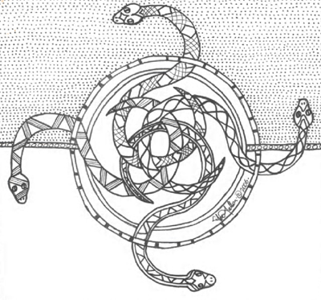
Indigenous Culture Overview http://shareourpride.reconciliation.org.au/sections/our-culture /
Kinship and family:
The Dreaming:
Country:
Language:
The Environment:
Customary Law:
Notes:
Picture: 'Rainbow Serpent' by Yveane Fallon
https://www.humanrights.gov.au/publications/mother-us-taken-away-kids-commemorating-10th-anniversary-bringing-them-home-report

Slide 11
Aboriginal Relationship with the Land
“for many Indigenous people it’s a visceral connection; you look beyond the buildings and concrete and feel a sense of belonging.”
(Aboriginal dancer and choreographer, Francis Rings, n.d.)
“We cultivated our land, but in a way different from the white man. We endeavour to live with the land; they seemed to live off it.”
(Tom Dystra, Aboriginal elder, Time Out Sydney, 2008 p.7)
“It's like the love for your mum and dad.”
(Natasha Neidje, grand-daughter of Bill Neidje, about the love for the land, Kakadu National Park)
“If you belong there your country will find a way to call you back. Country needs to be remembered, needs to be listened to, needs to know that we can still speak its language.”
(Aboriginal elder in TV series Double Trouble)
Notes:
www.CreativeSpirits.info, Aboriginal culture - Land - Meaning of land to Aboriginal people, retrieved 10 July 2015 Source: http://www.creativespirits.info/aboriginalculture/land/meaning-of-land-to-aboriginal-people#ixzz3fUiXHlbL
Source: http://www.creativespirits.info/aboriginalculture/land/meaning-of-land-to-aboriginal-people#ixzz3fUdbeU6g

Slide 12
Aboriginal Relationship with the Land
Discussion Questions:
How do non- Indigenous people potentially view land in terms of ownership?
Describe the relationship between the land and Aboriginal culture.
Dwayne says ‘We have a strong connection to the land. It gives us life’. Explain why land is so important to Aboriginal and Torres Strait Islander people?
Define the word visceral.
What do you think a sense of belonging entails?
What effect do you think white settlement had on Aboriginal and Torres Strait Islander people?

Slide 13
Frontier Wars
European settlement of Australia was not a peaceful process. For most Indigenous people it is described as an invasion of their land. As the British started to claim more and more land for farming, many battles were fought between the British colonisers and Aboriginal groups who were defending their country, their families and their livelihoods. Without the use of guns and horses, Indigenous warriors used guerrilla warfare to fight back.
Notes:
http://www.myplace.edu.au/decades_timeline/1840/decade_landing_16_1.html?tabRank=2&subTabRank=2

Slide 14
Frontier Wars Handout
Think, Pair and Share
Define the terms
Complete the close passage
Notes:
Foster, R 2009, “Don’t mention the war: frontier violence and the language of concealment,” History Australia, Vol 6, n.3, 2009, Monash University E-press.
http://journals.publishing.monash.edu/ojs/index.php/ha/article/viewFile/ha090068/110

Slide 15
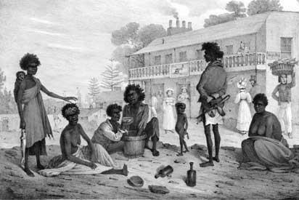
We Are Going Poem Analysis Oodgeroo Noonuccal (Katherine Walker)
Notes:
Intertextuality

Slide 16
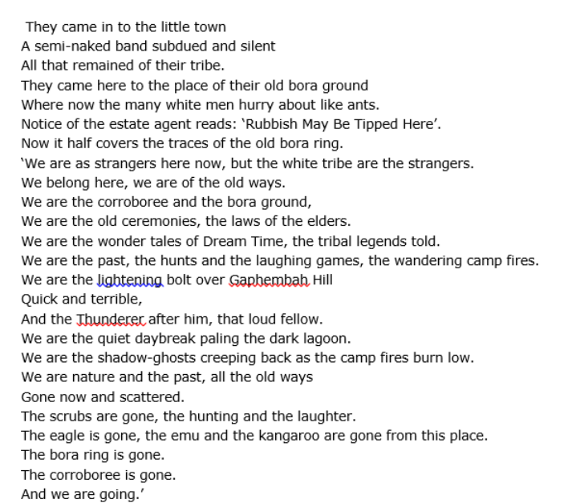
Notes:
http://www.poetrylibrary.edu.au/poets/noonuccal-oodgeroo/we-are-going-0771055

Slide 17
Analysis Questions
1. Explain why they are “silent and subdued”.
2. How are white men represented? Why?
3. What is a bora ring and explain why it is so central to this poem.
4. Explain their reaction in line 8.
5. Lines 9-17 begin a ‘litany’. What is the effect produced?
6. Comment on the significance of metaphors used in the poem.
7. Comment on the structure and form of this poem.
8. Why does Thunder have a capital letter?
9. Comment on the mood and atmosphere created.
10. Combine comments on its theme, title and conclusion.

Slide 18
Venn Diagram
Next Lesson
Colonial Attitudes Values and Beliefs
Aboriginal and Torres Strait Islander Attitudes, Values and Beliefs
Reconciliation

